Slide 1
Fire Safety and Utility Controls
BRM CERT TRAINING

Slide 2
Unit Objectives
What is fire safety
Identify and reduce potential fire hazards
Explain basic safety precautions
Home fire safety

Slide 3
The Fire Triangle
Heat
Fuel
Oxygen

Slide 4
5 Classes of Fire
A: Ordinary combustibles
B: Flammable and combustible liquids
C: Energized electrical equipment
D: Combustible metals
K: Cooking oils
Why is knowing fire classes important?

Slide 5
Home Fires
What is the #1 cause of home fires?

Slide 6
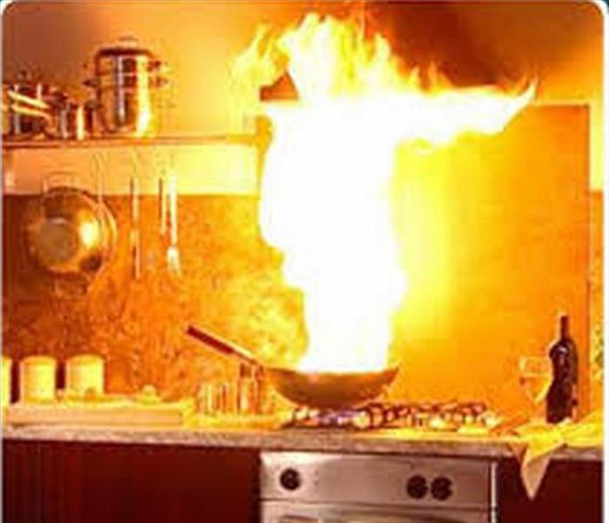
Home Fires
Yes, cooking fires!

Slide 7
Home Fires
What is the #2 cause of home fires?

Slide 8
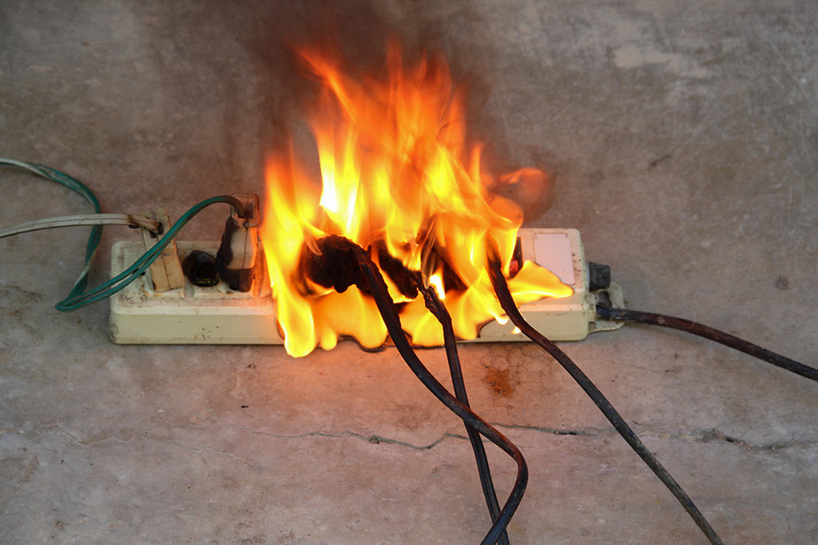
Home Fires
Electrical overload.

Slide 9
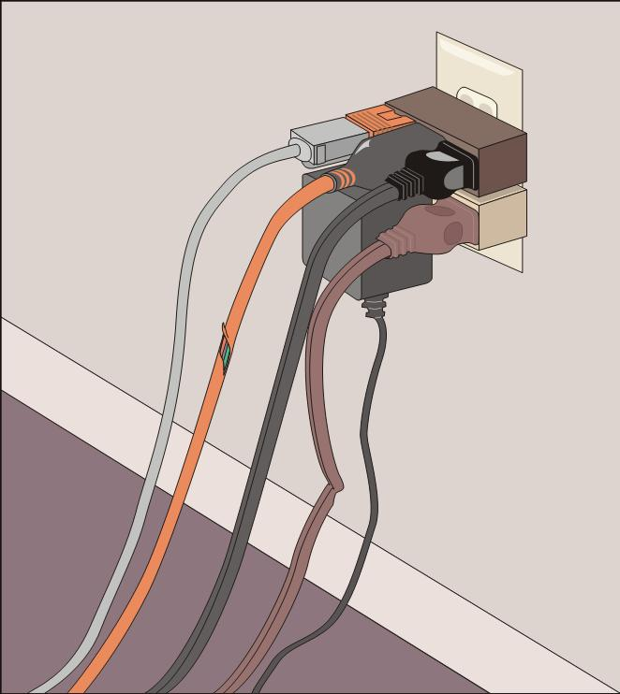
Reducing Electrical Hazards
Avoid the “electrical octopus”
Don’t run cords under carpets
Check for and replace broken or frayed cords
Maintain appliances

Slide 10
Reducing Electrical Hazards
This is a no – no!

Slide 11
Reducing Electrical Hazards
Throw this extension
cord away!

Slide 12
Reducing Electrical Hazards
What we find in homes:
Microwave ovens plugged into a power strip
Toasters left plugged in when not in use
Wires running under a rug or carpet
Cluttered power strips
Not an electrical hazard: Cluttered hallways

Slide 13
Electrical Emergencies
Know where power shutoffs are for:
Appliances
Circuit breakers
Fuses
Post shutoff directions next to all utilities
Know procedures for turning power back on

Slide 14
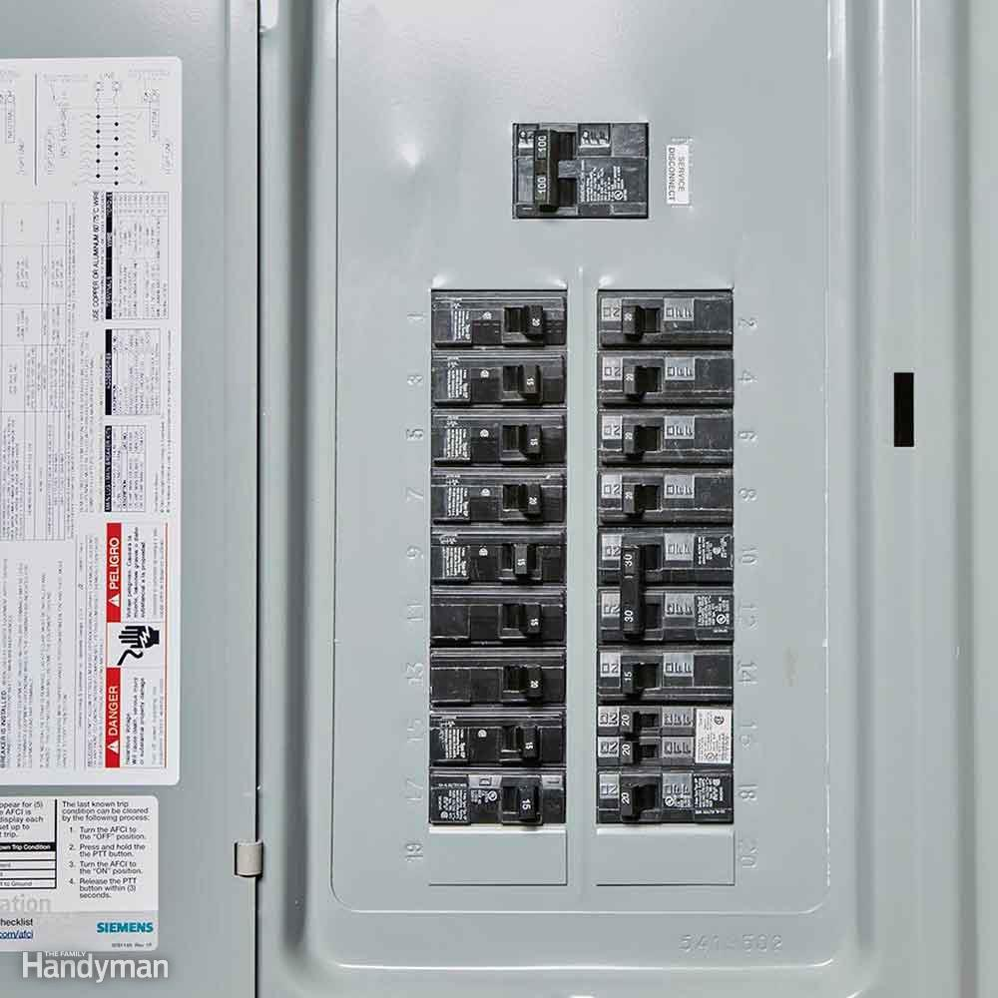
Shutoff Procedures
Circuit box with shutoff:
What does shutoff mean?

Slide 15
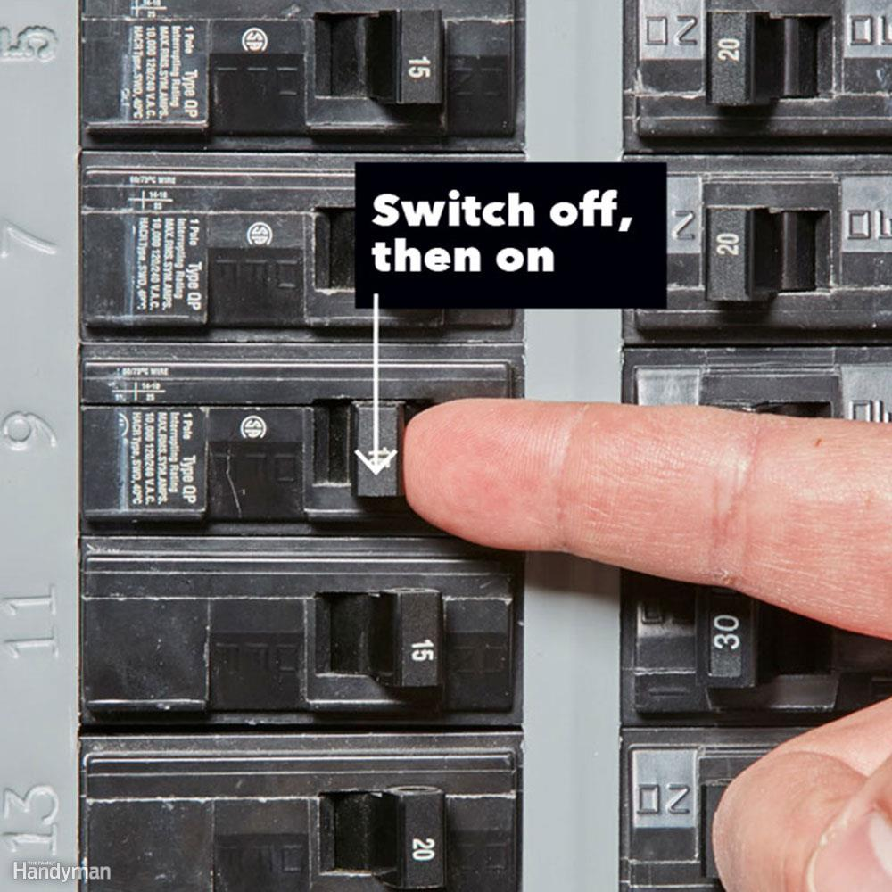
Shutoff Procedures
Off
On

Slide 16
Other fire hazards
Candles
Smoking: Lit cigarette
Matches
Natural Gas

Slide 17
Natural Gas Hazard Awareness
Install natural gas detector
Install carbon monoxide detector in home
Test batteries for natural gas and carbon monoxide detectors every month
Change batteries every 6 months
Locate and label gas shutoffs
Have proper non-sparking tool

Slide 18
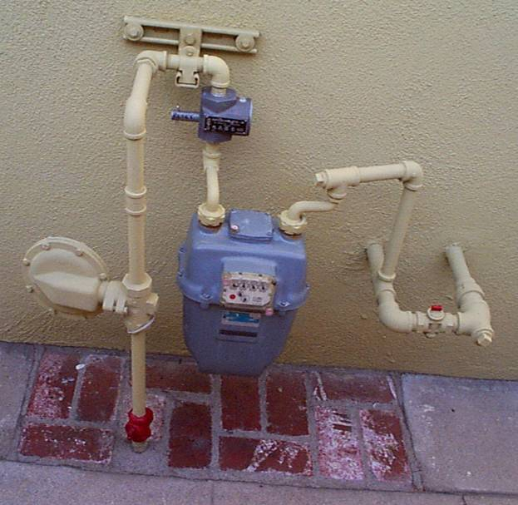
Gas Shutoff
Locate and label gas shutoff valves
If not automatic, know procedures for shutting off gas

Slide 19
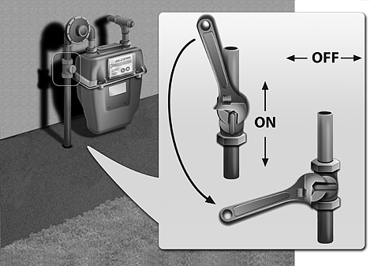
Gas Shutoff

Slide 20
Smoke Alarms
Typical smoke alarm
Lithium Ion battery last 10 years
If smoke alarm starts chirping, remove & replace smoke alarm
Recommend testing once a month
Placement: One in each bedroom & one in the hallway. Do not install in the kitchen or close to bathrooms, washer & dryer.

Slide 21
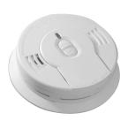
Smoke Alarms
Typical smoke alarm
Light
Clean
Clean
Test button

Slide 22
Smoke Alarms
Special Smoke Alarms: For the hearing impaired
Bed Shakers
Flashing Lights

Slide 23
Smoke Alarms
Purchase at City Mill, Home Depot, Lowes
Or, call the American Red Cross
739-8111

Slide 24
Smoke Alarms
Or, call the American Red Cross for the annual Smoke Alarms For Everyone (SAFE) HFD & IBEW retirees
739-8111

Slide 25
Smoke Alarms

Slide 26
Fire Escape Plan
The smoke alarm wakes you, what do you do?
Does your family know what to do?

Slide 27
Fire Escape Plan
You hear the smoke alarm chirping.
Roll out of the bed, stay low to the floor.
Wake your family, you have two minutes to escape.
Everyone follows the fire escape plan.
Your family exits the house and meet at the designated meeting place.
Now, call 911.

Slide 28
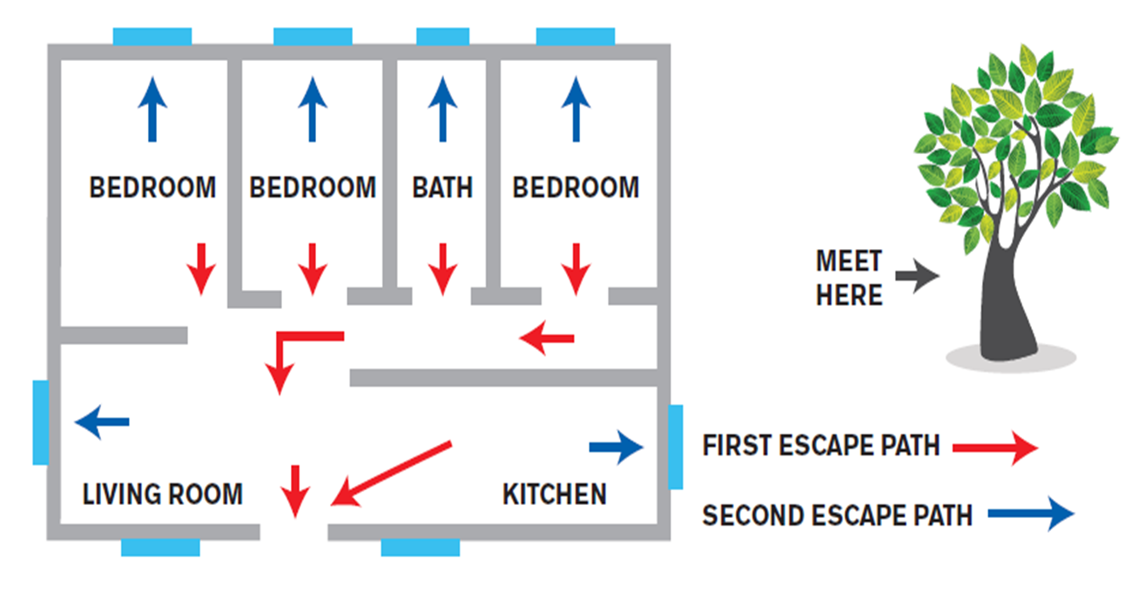
Notes:
This is what a finished plan would look like. It’s important for the residents to consider who would be in each room and is it feasible that grandma could go out the second floor window.
Also make sure they identify a meeting area a safe distance away from the house. It is important to know who might still be in the building, and if everyone is waiting on different sides of the house they might not see each other.

Slide 29
Fire Escape Plan
What happens if your family member is bed ridden?
What happens if you have an infant?
What happens if your primary escape route is blocked by fire?

Slide 30
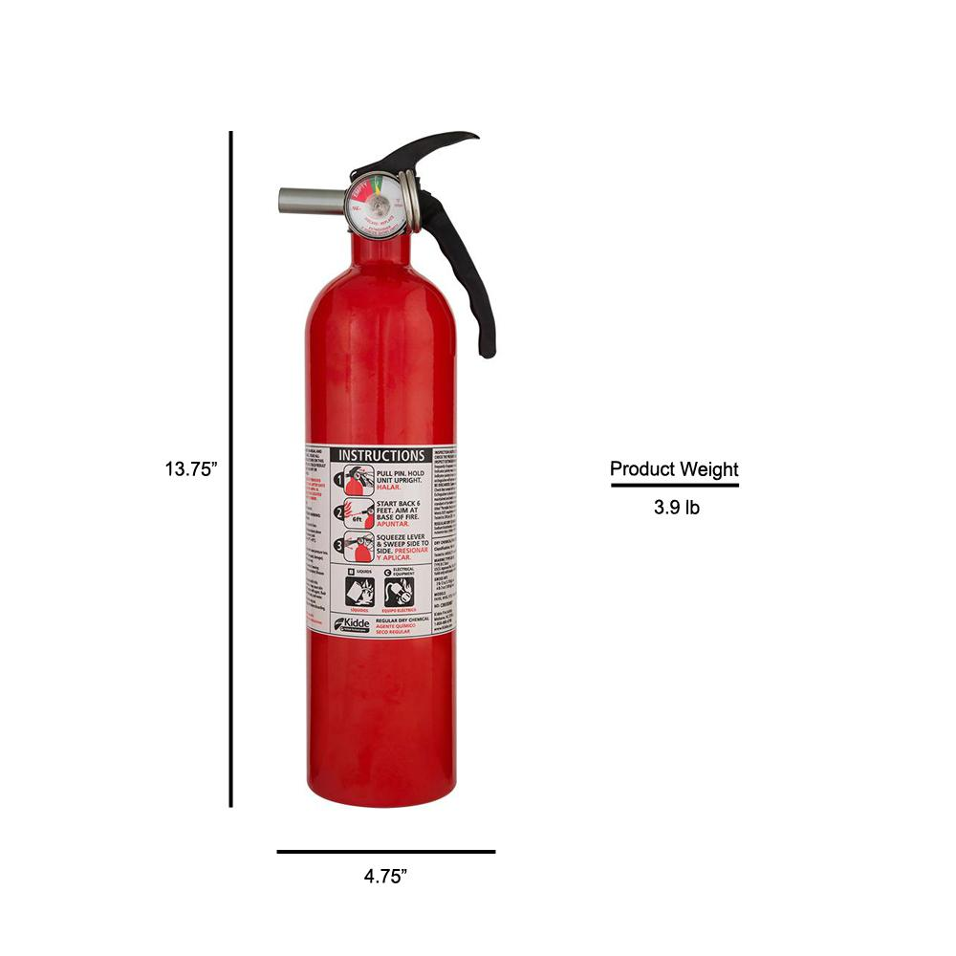
Firefighting Resources
Portable fire extinguishers
Extinguish Class A, B & C
Check the pressure gauge
If the fire extinguisher has been sitting idle for a long time, shuffle the fire extinguisher
Pressure gauge
Label

Slide 31
Wild Fires
Surface Fires: Fires that burn on the ground, usually leaves, grass, twigs
Ground Fires: Fires that burn below the ground, usually roots, buried stumps, organic soil
Crown Fires: Fires that ascend from the ground into the crown canopy of trees

Slide 32
Unit Summary
What is fire safety
Identify and reduce potential fire hazards
Explain basic safety precautions
Home fire safety

